Slide 1
Amazon Web Services
-Harika Devineni

Slide 2
Introduction
The full form of AWS is Amazon Web Services.
It is a platform that offers flexible, reliable, scalable, easy-to-use and, cost-effective cloud computing solutions.
AWS is a comprehensive, easy to use computing platform offered Amazon.
The platform is developed with a combination of infrastructure as a service (IaaS), platform as a service (PaaS) and packaged software as a service (SaaS) offerings.

Slide 3
When to use Aws VM
Amazon VM(EC2 Instances) is one of the Amazon Web Services and allows to run applications on the cloud.
It provides you with complete control of your computing resources and lets us to run on Amazon's proven computing environment.
Amazon EC2 offers the broadest and deepest compute platform with choice of processor, storage, networking, operating system, and purchase model.

Slide 4
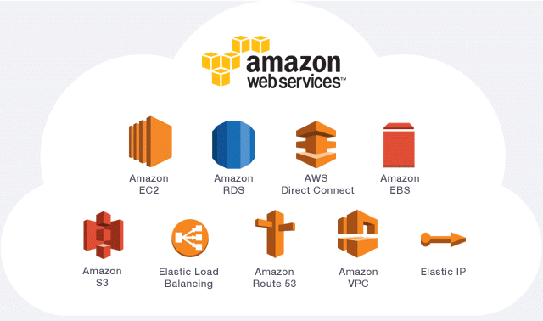
Aws Services

Slide 5
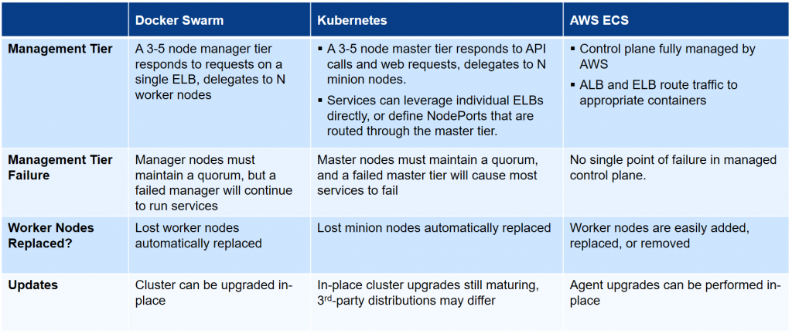
Aws Container vs Aws Kubernetes
Kubernetes
Container

Slide 6
Aws Functions
AWS Step Functions is a low-code visual workflow service used to orchestrate AWS services, automate business processes, and build serverless applications.
AWS Step Functions lets to add resilient workflow automation to your applications in minutes—without writing code.
Workflows built with Step Functions include built-in error handling, parameter passing, recommended security settings, and state management, reducing the amount of code to write and maintain.

Slide 7
Aws Virtual Desktop
A virtual desktop allows users to access their desktop and applications from anywhere on any kind of endpoint device.
Amazon Work Spaces is a fully managed desktop virtualization service that enables you to securely access data and applications from any supported device.
You can mix monthly and hourly billing within your AWS account, and you can also switch between billing options at any time during a billing period.

